Slide 1
Lecture 18
Chemical Engineering for Micro/Nano Fabrication

Slide 2
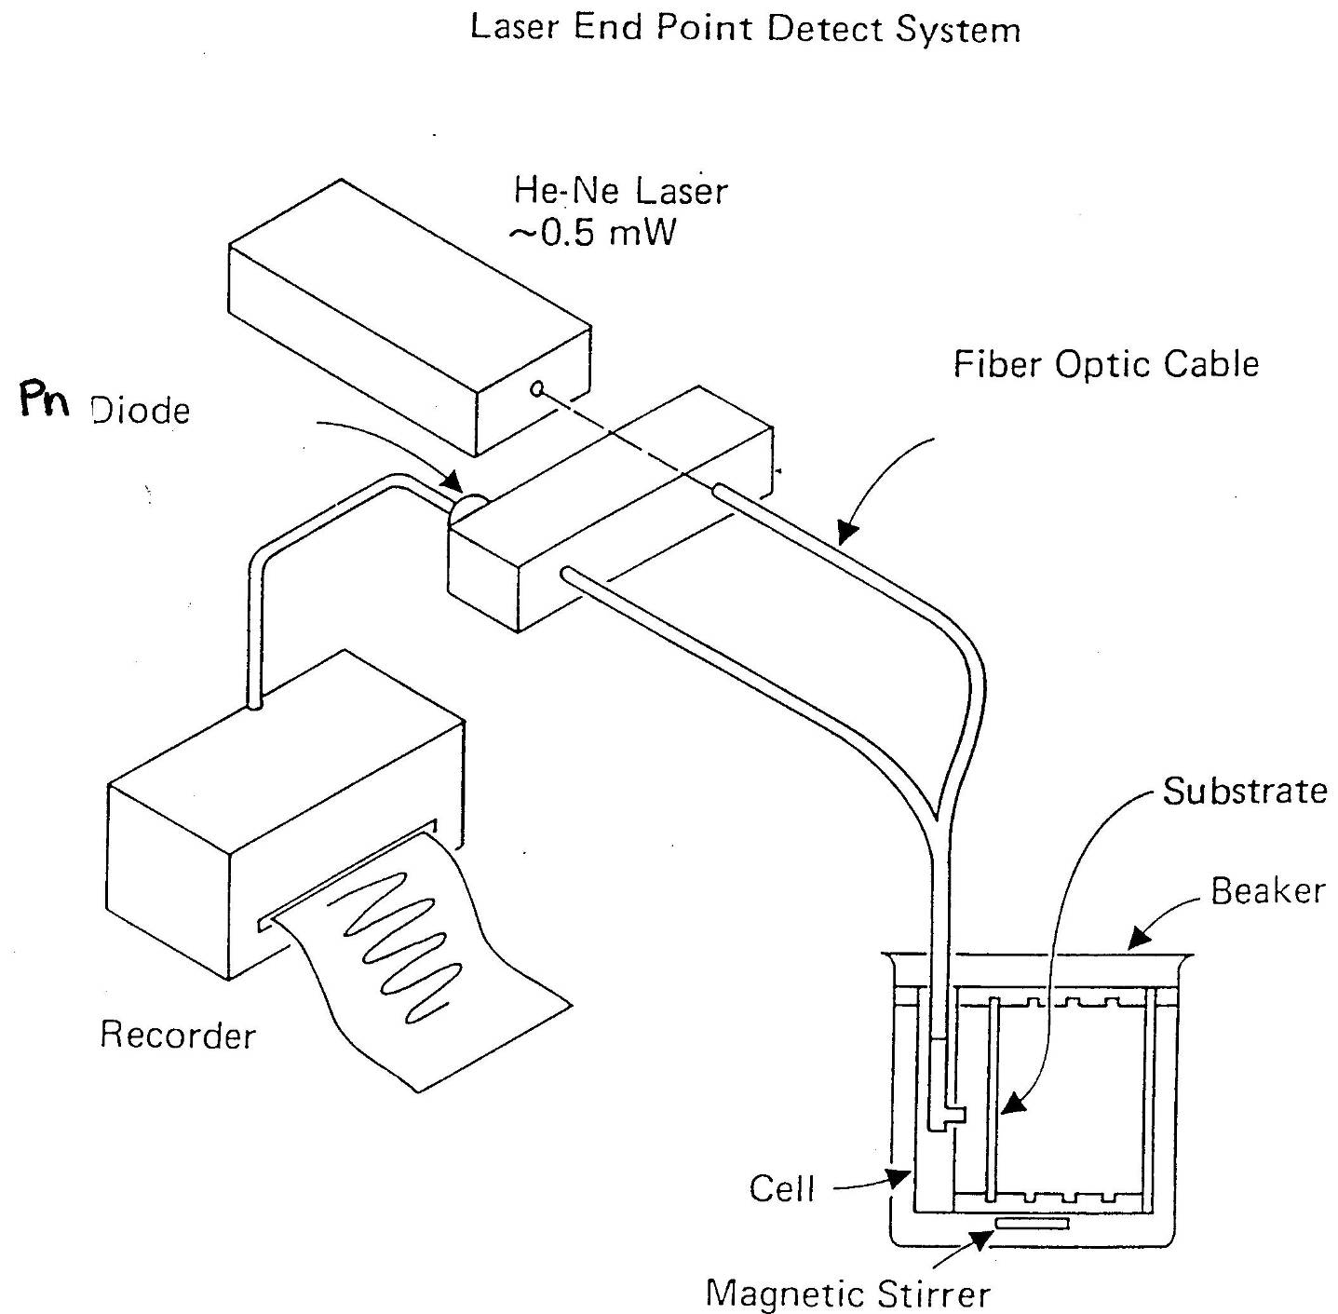

Slide 3
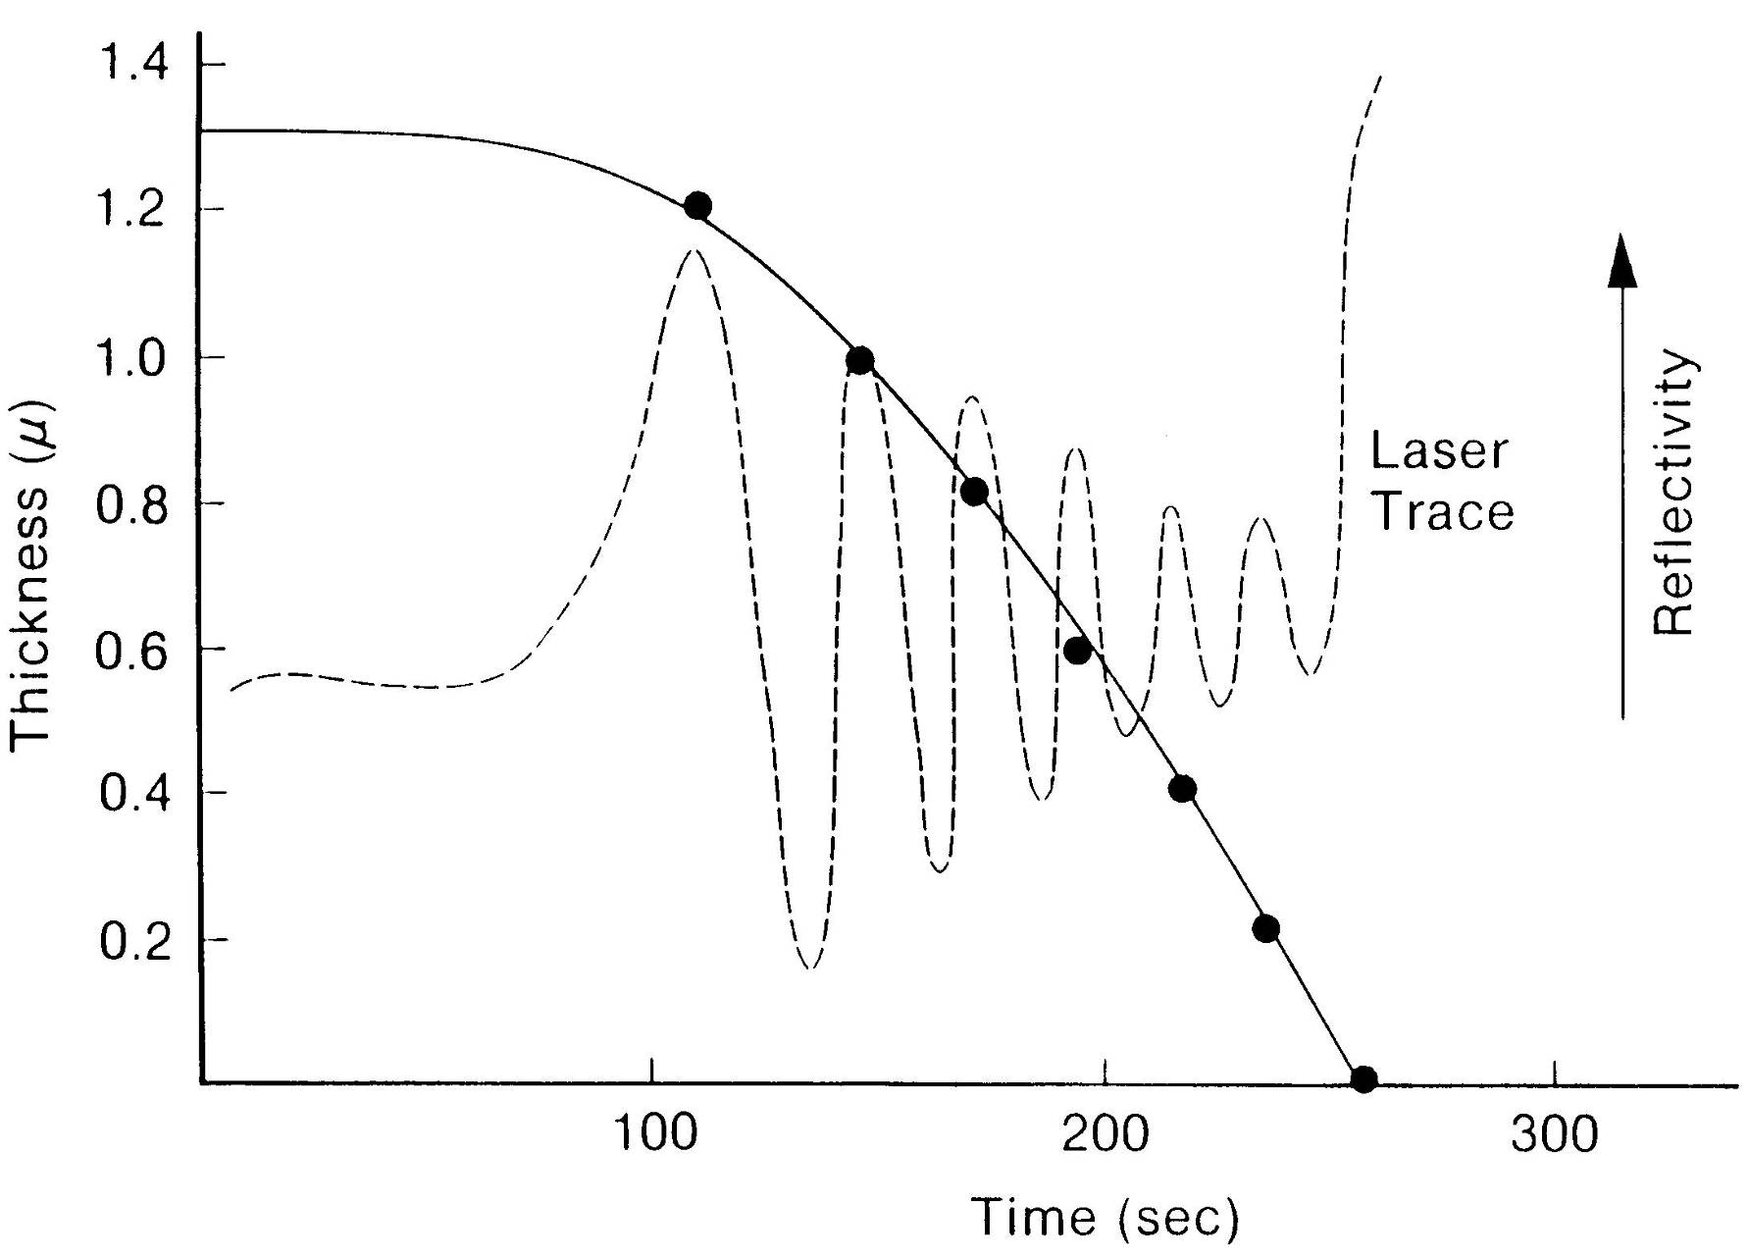
$$∆T= \frac{λ}{2N}≈ \frac{0.63μ}{\left.2(1.5\right)} ≈0.2μ$$

Slide 4
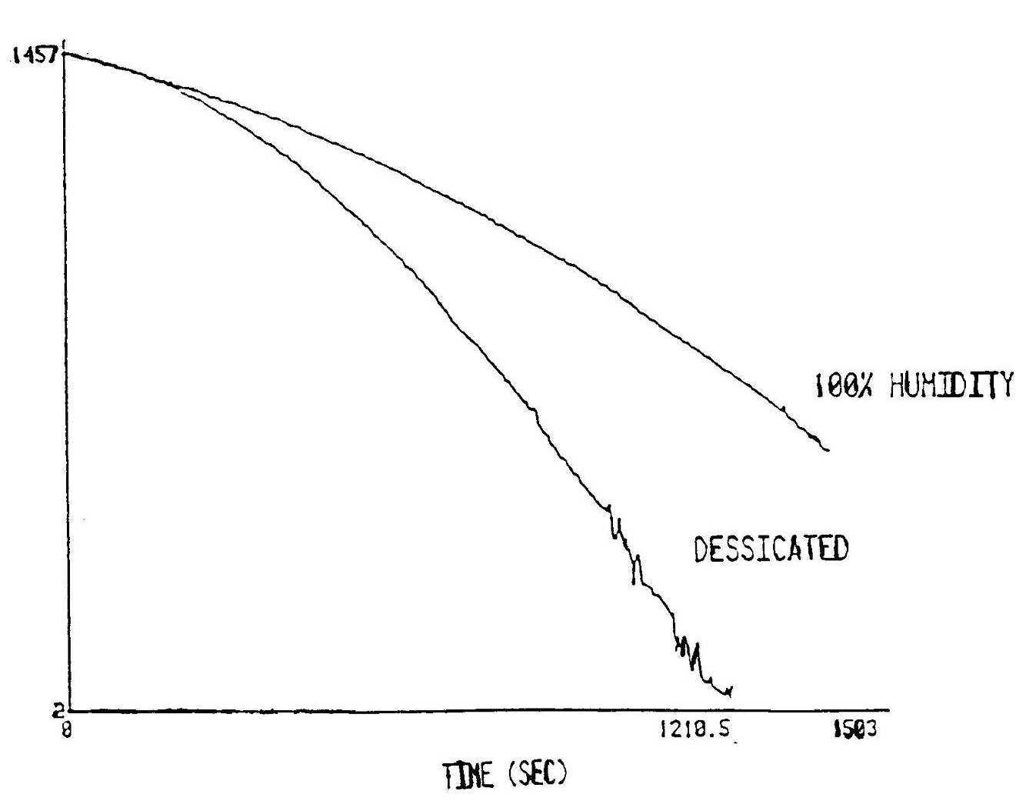
Effect of Humidity on Dissolution Rate

Slide 5
Dissolution Rate vs Post Apply Bake Temperature

Slide 6
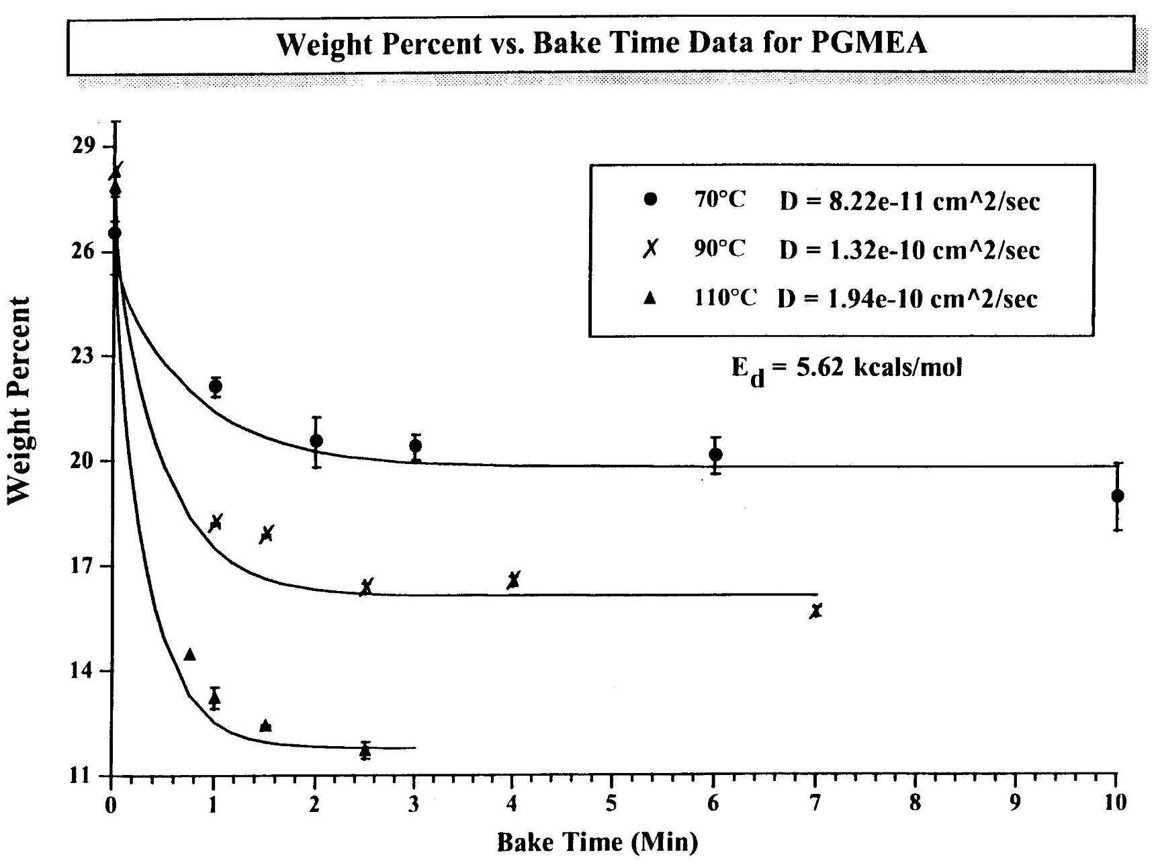
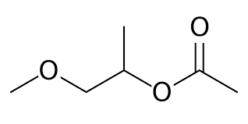

Slide 7
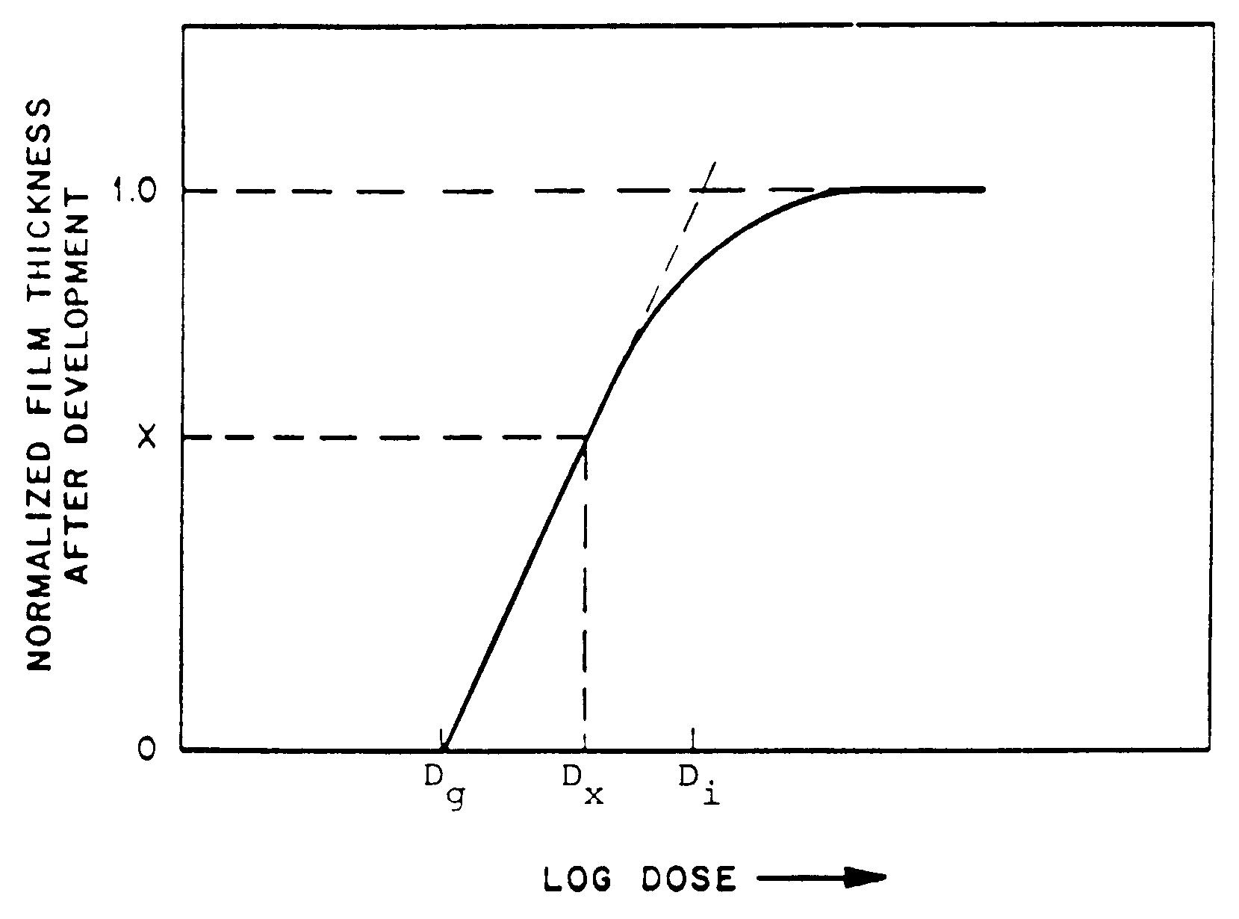
Negative Resist Characterization

Slide 8
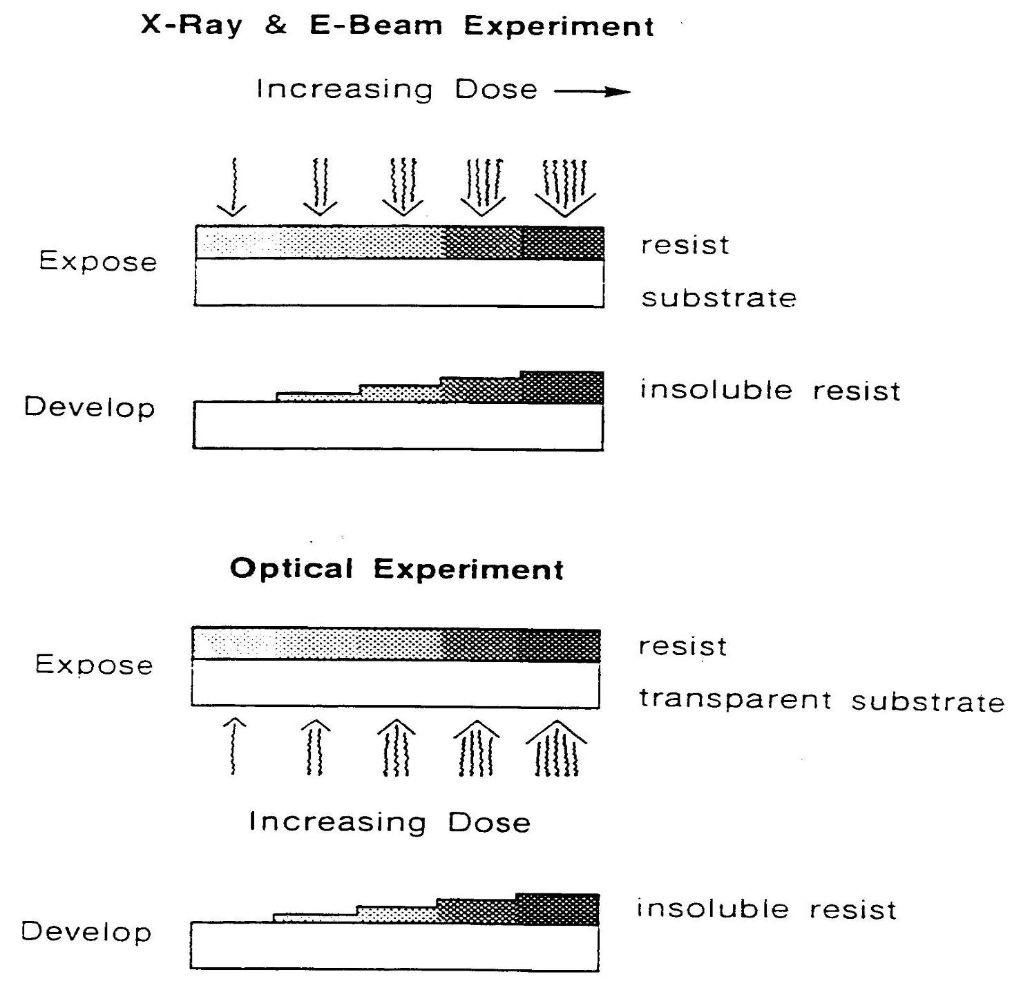

Slide 9
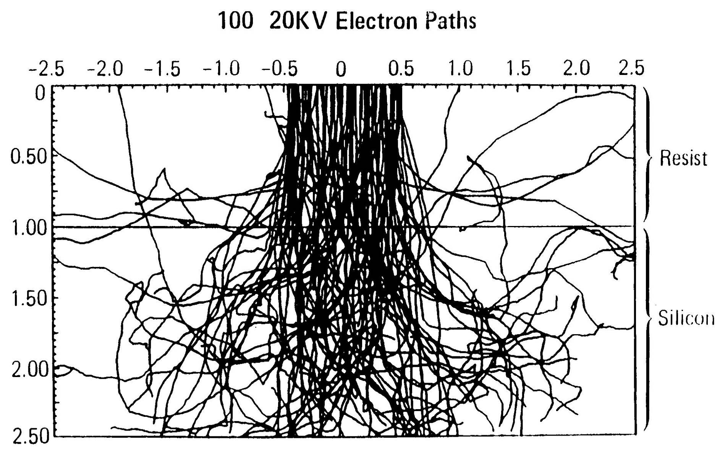
Simulated Electron Beam Exposure

Slide 10
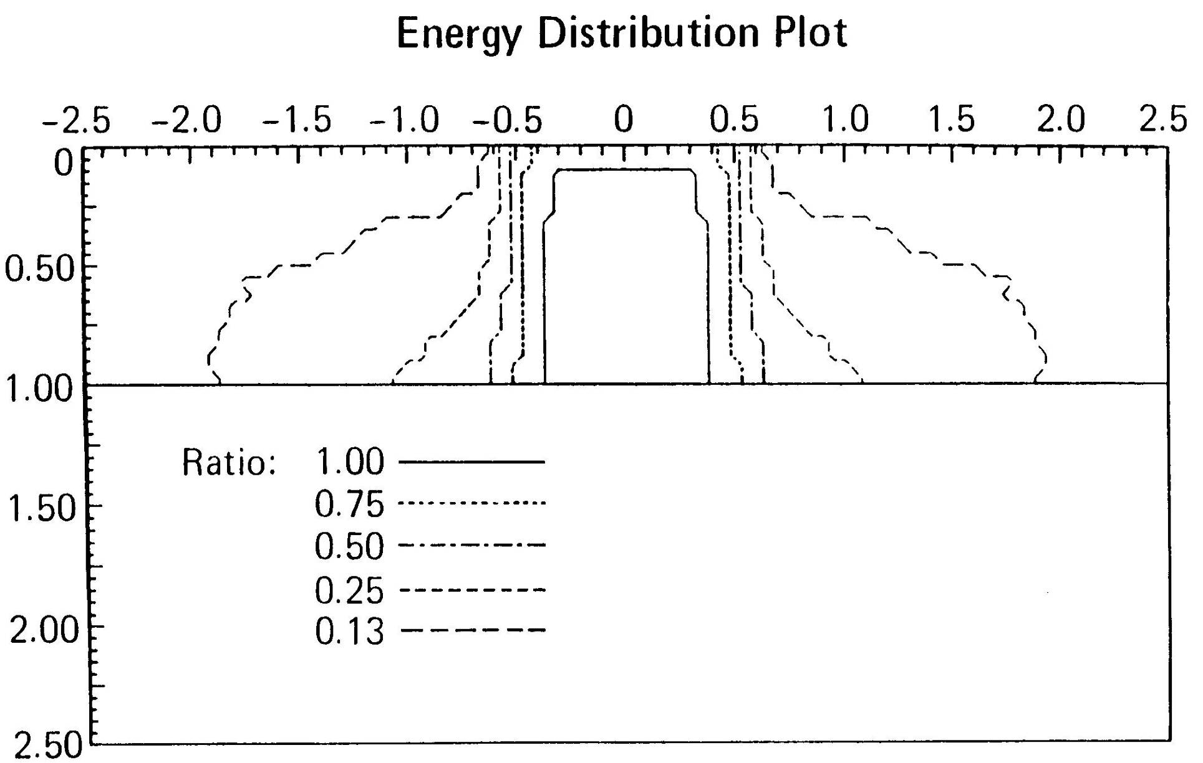

Slide 11
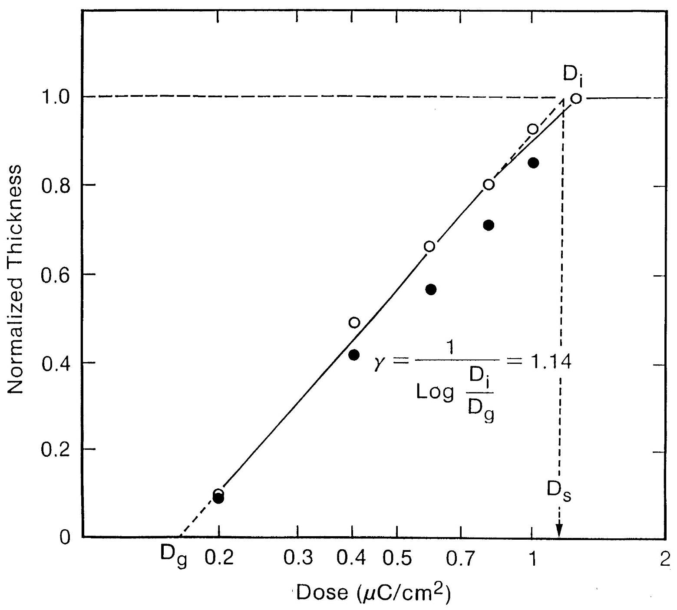

Slide 12
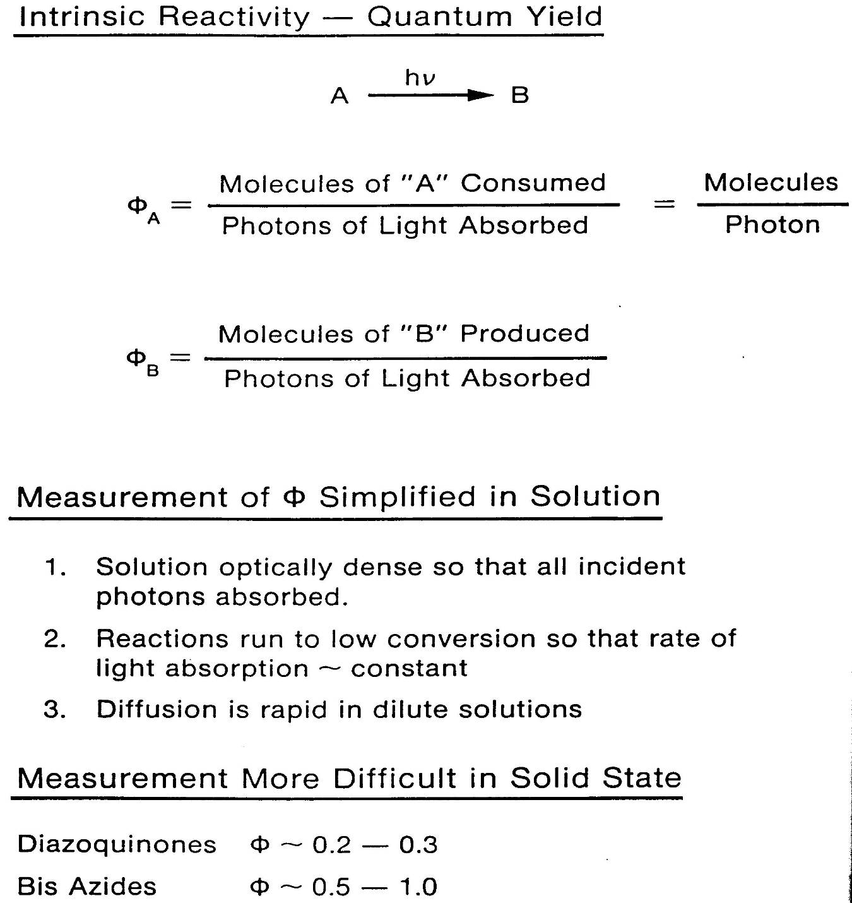

Slide 13
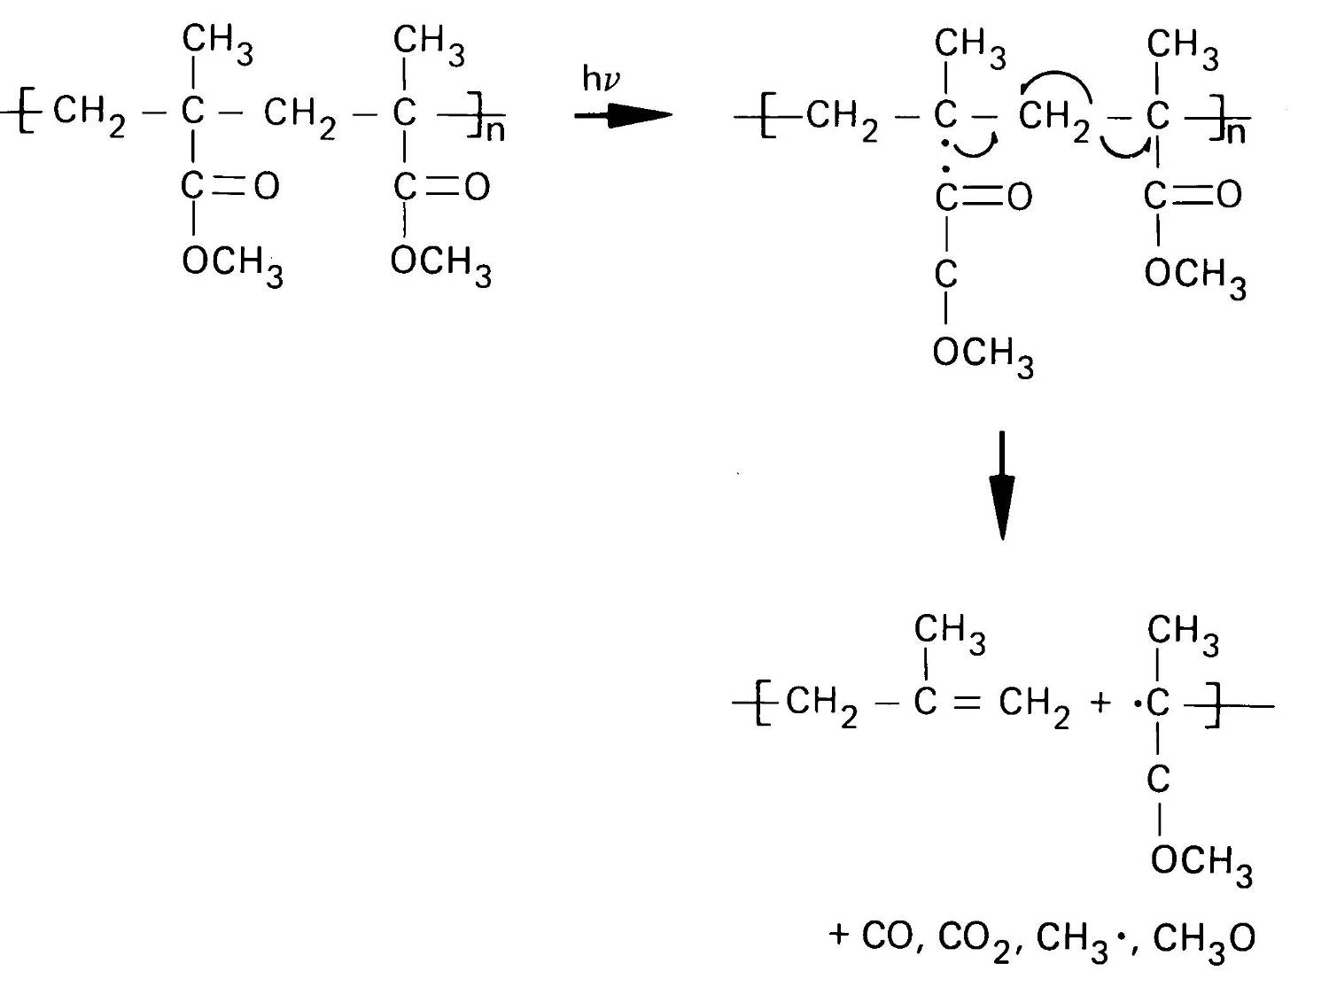
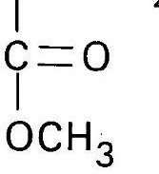
Radiation Induced Decomposition
of Poly(methyl methacrylate), PMMA

Slide 14
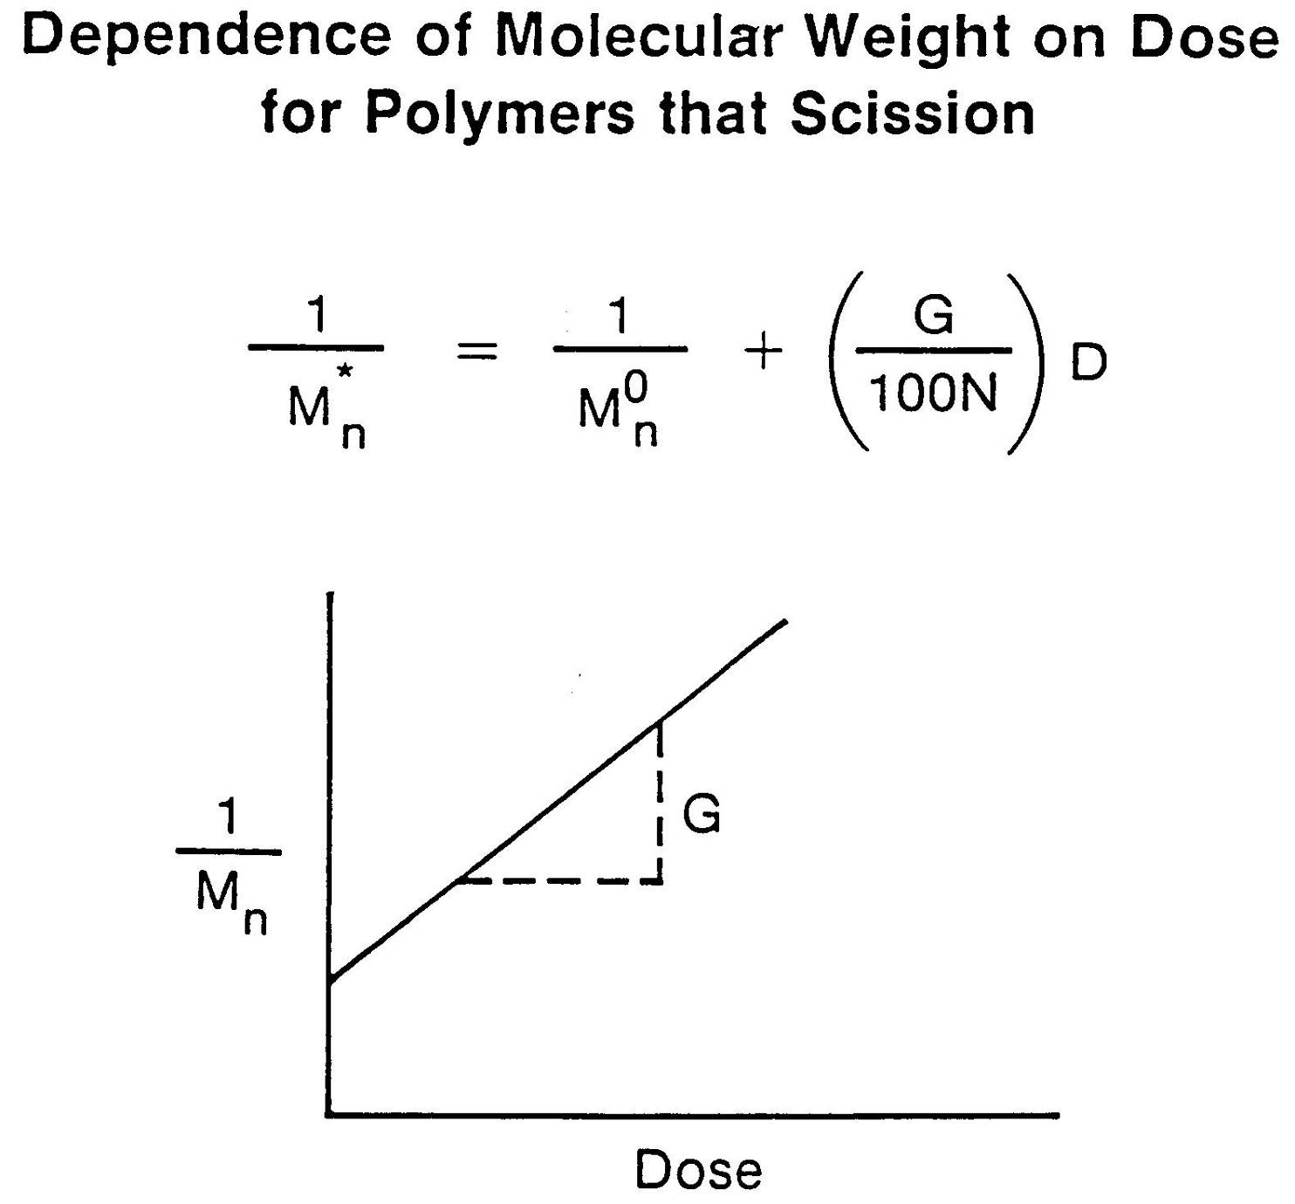

Slide 15
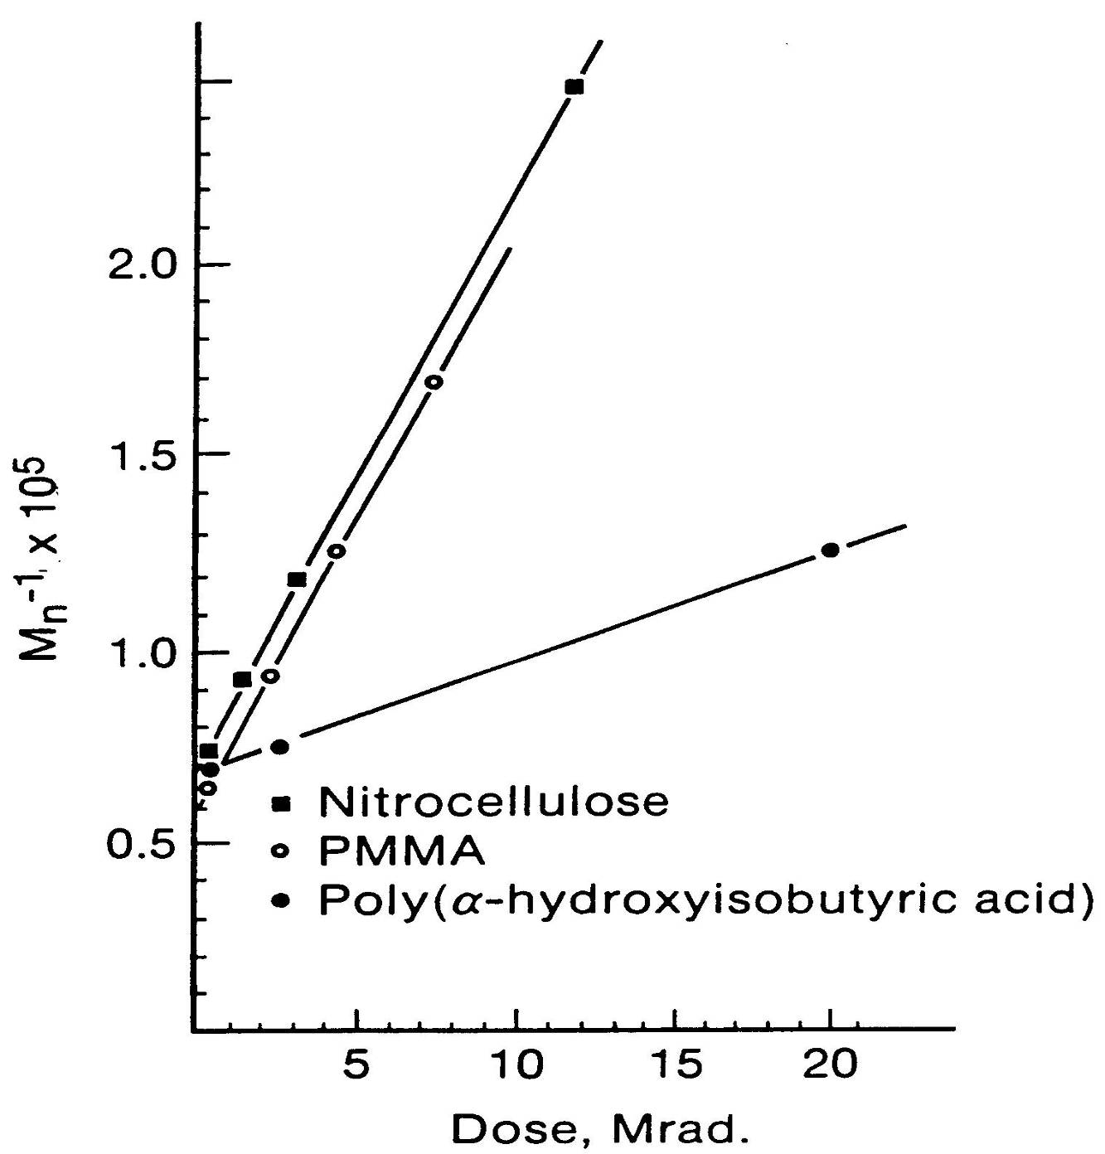
Measuring “G” Values

Slide 16
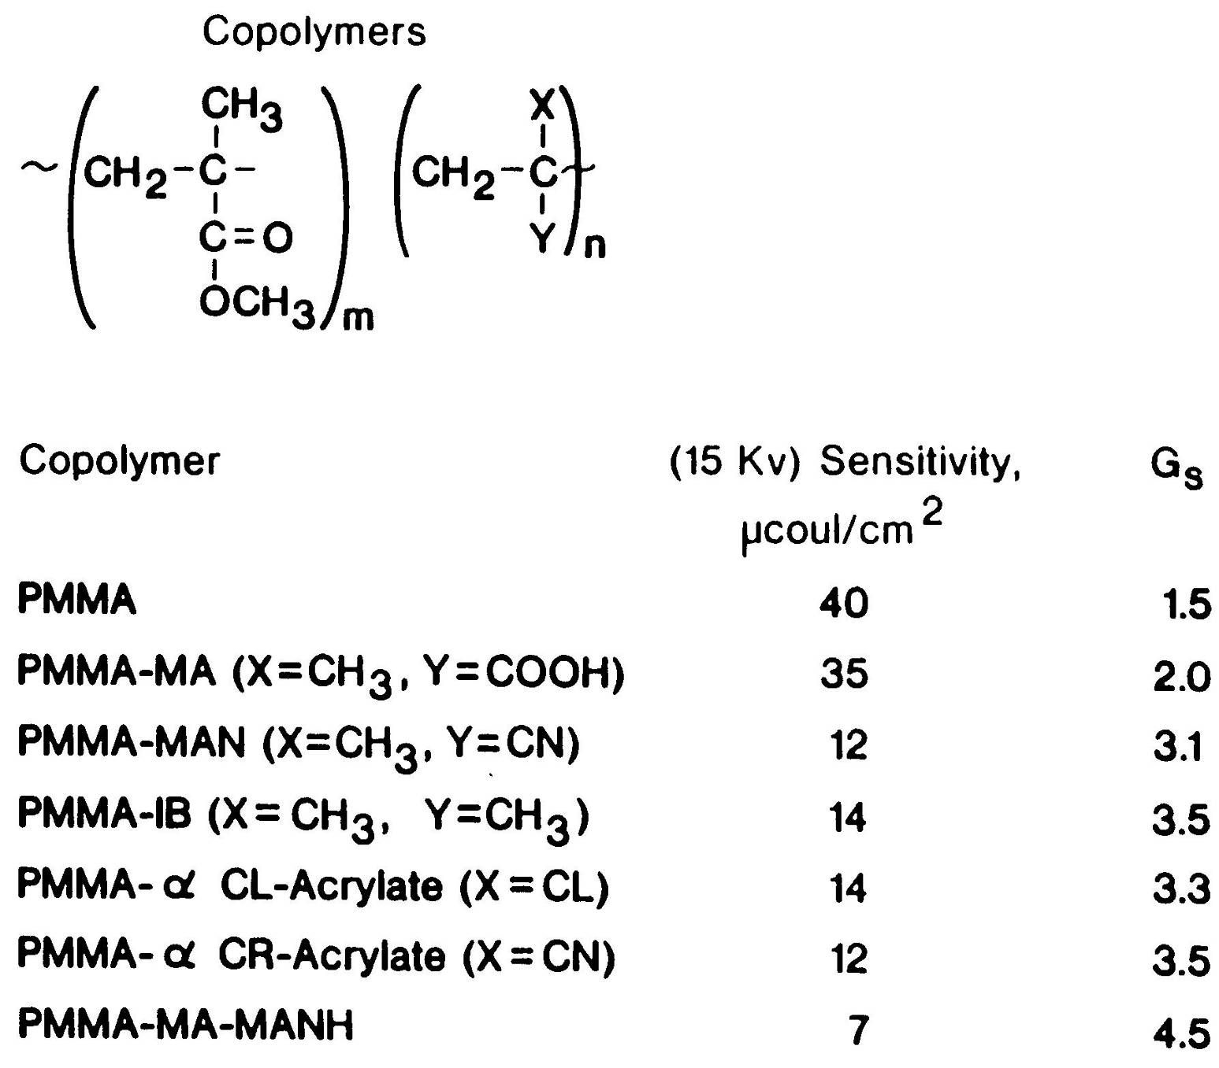
“G” Values

Slide 17
Lithographic Sensitivity
CAUTION…
RESIST SENSITIVITY EXPRESSED IN TERMS OF DOSE/UNIT
AREA IS LIKE AN EPA MILEAGE RATING… USE IT FOR
COMPARISON ONLY. YOUR OWN MILEAGE WILL VARY
DEPENDING ON…

Slide 18
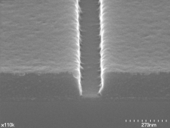
Defocus Behavior: a 193 nm Resist
100nm (1:1.1) Trench DOF @
²
38.0 mJ/cm
0.110µm
0.115um
0.112µm
0.116um
0.112µm
0.116µm
0.112µm
0.114µm
0.114µm
-
0.40µm
-
0.35µm
-
0.30µm
-
0.25µm
-
0.2µm
-
0.15µm
-
0.10µm
-
0.05µm
0.0µm
0.107µm
0.111µm
0.111µm
0.109µm
0.110µm
0..113µm
0.116um
0.115µm
0.115um
0.117µm
0.112µm
0.116µm
0.114µm
0.115µm
+0.45µm
+0.4µm
+0.35µm
+0.30µm
+0.25µm
+0.2µm
+0.15µm
+0.10µm
+0.05µm
120
à
100
nm Isolated Trench
-
0.
1
5µm
-
0.
1
0µm
-
0.05µm
0.00µm
+ 0.
05
µm
+0.10µm
+0.20µm
+0.30µm
+0.35µm
180
à
100nm
Isolated LINE
-
0. 15µm
-
0.
1
0µm
-
0.05µm
0.
0
µm
+0.
0
5µm
+0.
10
µm
+0.20µm
+0.35µm
+0.4
0
µm
Exactly what does this measure???

